Slide 1
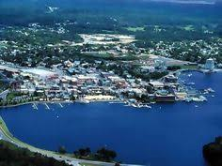

Hometown Housing Development
21 March 2019
Notes:
Good evening. I am Nan Normand and I have served on the executive of Making Kenora Home for many years now. I want you to know how excited I am to be here tonight. So much is happening in our community right now and it is a pleasure to see the recognition of the need for housing development within our hometown. Amidst the celebration of current developments, this is a good time to review our past and vision our future.

Slide 2

Notes:
Shelter is a basic need for all human beings-even if you are in a tropical paradise!.
Let’s look at how we got to today by taking a quick scan of Kenora over the previous few centuries. Understanding how we got here helps us to understand the current barriers to housing development.

Slide 3
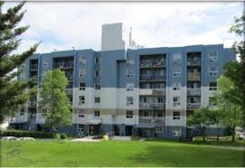
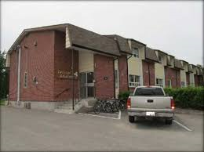
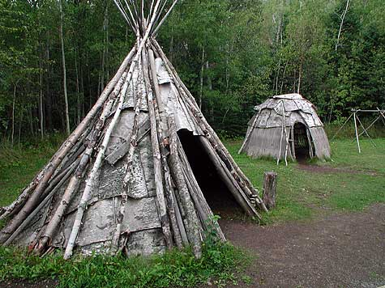
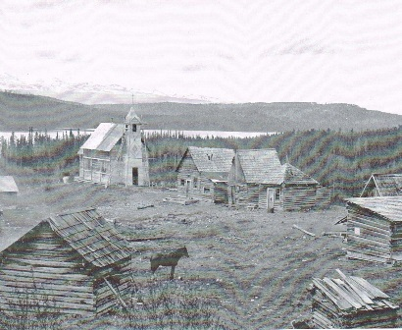
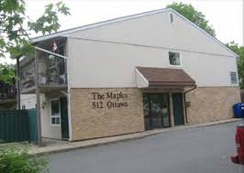
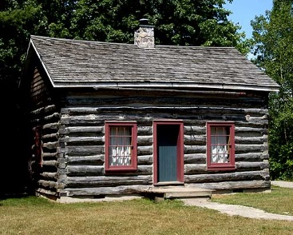
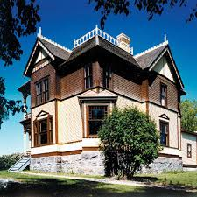
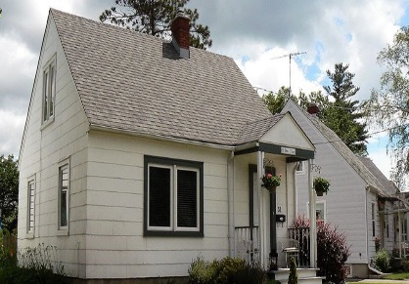
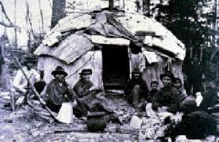
Local Housing Time Line
Anishinabe Traditional Lands
Indian Act Impacts
Social Housing
Pre-1700’s early 20th century 1960’s-80’s
1800’s mid 20th century 1993-2006
Colonialization
Urbanization
Benefit Housing
Notes:
In pre-colonial times, the local Anishinaabe peoples lived in homes that were easily assembled from free resources around them. The homes were functional and were holistic in that they were part of the land. They didn’t deplete resources and were entirely biodegradable.
As colonialization began, the European style of stationary building required land ownership and outsourcing of some building supplies which incurred costs. In the earliest years the colonialist homes coexisted with the indigenous homes with some crossover.
The late 1800s and early 1900’s brought in the Indian Act which pushed indigenous peoples onto reserve land that copied European housing styles albeit without luxury. The colonialists began urbanizing this area. Homes expanded and became more elaborate. Local building resources began to be depleted and the need for land increased conflict between neighbours but with the racial separation created through the Indian Act, the conflict tended to be between settlers.
I would like to interject a story from that was told during this year’s Walk in Other Shoes challenge. During the depression there was a widow with six children living in Keewatin where she still resides. Her home was built by neighbours using their own time and sharing materials as needed. It is our own historical version of Habitat for Humanity. It could be done at this point because zoning and building codes weren’t what they are today.
Moving on to post World War II-you can still see some of the local war time housing that was build for the benefit of returning soldiers. Home ownership was made more affordable but there was underlying assumption that was a social benefit for the deserving. The homes were simply designed and functional but did have building costs that were government subsidized.
This building gained momentum until the golden years of social housing-the late 60’s to early 80’s in Kenora. Affordable housing was promoted and subsidized by the government as social development for all citizens. In 1993 that all changed. It was no longer a priority which brings us to the 21st century.
In a perfect storm, social housing investment declined while income disparity increased. We are in a time of homelessness that we haven’t experienced since the Great Depression. In the previous 10 years, our homeless population has tripled locally. The challenges that beset the population are much more complex than in the 30’s but the good news is that Housing First has been proven effective for even the most difficult to serve individuals.
Housing First requires two things-housing units and housing supports. Ideally these two components are set up simultaneously but reality is that housing development takes longer to actualize than housing support programs. We know that housing support program funding can emerge out of the savings when Housing First is undertaken. It is admittedly a chicken and egg scenario but the chicken is bigger than the egg so lets begin with the establishment of the housing.

Slide 4
Historical Barriers To Housing Development
2000+
1900-1999
1800-1899
Pre 1799
Notes:
Back to our brief history of local housing. If you were listening during the previous slide, I spoke about land availability, increasing regulation and escalated costs. I also spoke of neighbour conflict, known today as NIMBYism (not in my back yard!). Here is what has happened over time. As resources dwindled, both costs and bureaucratic requirements. Our housing development has become more and more of contentious on all levels. We need to recognize this for what it is-social disparity, economics and exclusionary politics. We have created our own barriers to development and it is up to us to recognize the problems and change it so that we can bridge development towards a more inclusive community. With creativity and commitment, we can build.

Slide 5
Housing Project Needs
Construction Costs
-materials
-labour
Community Contribution
-citizen support
-infrastructure
Developmental Requirements
-building regulations
-financing
-land
Marketability
Financial Feasibility
Community Planning
Notes:
There are 3 components to any housing project and they have to come together to achieve synchronicity. When the development requirements are reasonable and the construction costs can be met within a budget, there is financial feasibility for the project. When developmental requirements meld with the will of the local citizens, community planning will support the infrastructure and zoning needed for the housing project. When the cost of construction is balanced with the needs of the citizens, housing projects become marketable. That sweet spot where all three components –feasibility, community planning and marketability- meet ensure proposal success. All of us have a role in development within our community-our political leaders, our available financial resources, our citizens. It is collaborate or fail.
Personally, I am not a housing developer nor am I a construction company. I do not have the land or the money to take care of these specific criteria but I am a citizen. I can participate in the community planning process to ensure that our municipal infrastructure supports affordable housing development. The proposed build by the Kenora Non-profit Housing Association is an example. They proposed a build. The City agreed to putting in the required infrastructure. Proposed changes for water billing have snagged the proposal but there is room for compromise and it is up to us as citizens to make this happen. Zoning changes are another hot button. We need to ensure that zoning benefits the entire community inclusively rather than being used as a tool to exclude populations due to unfounded fears and power plays. Tonight is a demonstration of community collaboration so kudos for everyone in attendance.

Slide 6
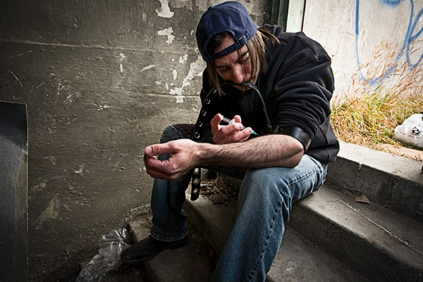

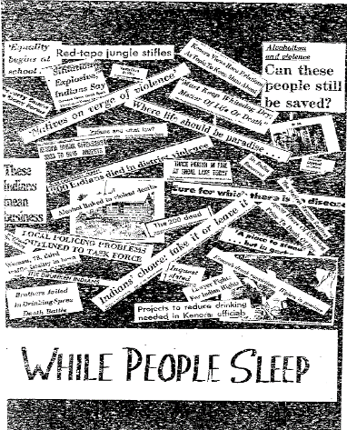


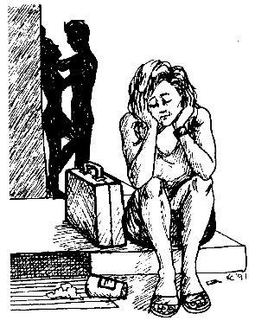

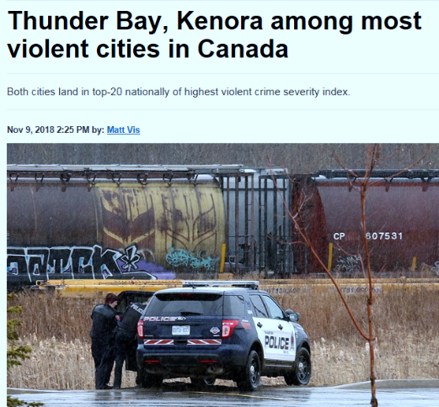

Community Change
The increased cost due to homelessness to the participating community services is $19,297.10 per person annually. This cost escalates with the age of the individual. The annual cost for the eldest senior subject was $35,5641.18.
Only 5 agencies participated in this limited study. Other stakeholder agencies bearing the cost of homelessness include correctional services, legal aid, emergency food providers, emergency shelter costs, family physicians, walk-in clinics and social services. Similar studies undertaken in other communities that have included services beyond those researched in Kenora estimated taxpayer costs at $35,000--$45,000 per person. Given the limited agency participation in the Kenora study, it is reasonable to expect that the local cost would be comparable.
At the time of the study there were 25 chronically homeless individuals identified within the community therefore the cost of providing emergency services to this population by the 5 participating agencies is $482,427.50
Local Homelessness Costing Study 2008
Making Kenora Home
tbnewswatch.com
Notes:
I am not going to tell you that building is the right thing to do. I am going to tell you that building is the smart thing to do and unlike the ranters on our infamous local rant and rave facebook page, I will reference the research instead of tossing bully bombs.
Kenora has problems. Some are the culmination of our history and some, like meth are imported. All mixed together, we have a mess. Where do we start? Our police have clearly told us that our crime rate is directly driven by addictions. Our health services are scrambling to address the plethora of patients who are also impacted by disabilities and trauma. Our educational system struggle with higher than average drop out rates and lower student achievement. Our workplaces struggle to staff their businesses at both ends of the economic pay spectrum. Where do we begin?
We begin with the recognition that shelter is a basic human need. When shelter is not available, people are more likely to require emergency services which come at a high cost. When shelter is not affordable, other human needs are sacrificed to pay the rent. We live in a time when for too many of our citizens each month is a financial juggling act between rent, food and utilities. You will never know about those who keep a roof over their heads-their sacrifices are not public but for those who have lost their home, we see their diminishment.
Service providers will tell you, there is no effective treatment for those who are homeless or at risk of homelessness because there is no stability. This is where Housing First comes into play. Once a person is housed, there is a potential for wrap around support services that can reduce health care costs as well as policing costs. I know that the OPP are trying their best to keep their costs down but these costs will continue to rise unless we can change outcomes for many of the people within our community. Outcomes can only be changed when Housing First is effectively provided. When a family is stably housed, education outcomes are improved as well as social connectivity which is crucial for child development. When a senior has affordable and accessible housing, the quality of their life improves impacting health outcomes. Jails, hospitals and long term care homes cost a lot more than supportive housing.
It is not about those people, it is about the overall well being of our community. We reduce costs through ensuring that we have affordable, appropriate and accessible housing for all of our citizens. This has been researched over and over again by many social scientists. In 2009 we did our own vertical study of marginalized persons during periods when they were housed and not housed. This format allowed us to show that the same individual had different emergency service usage patterns related solely to residency status.
Building smart social housing will create change opportunities for Kenora.

Slide 7
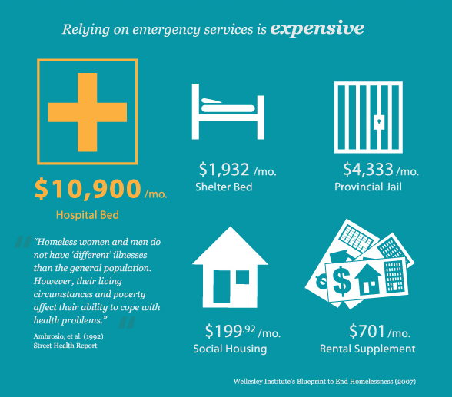
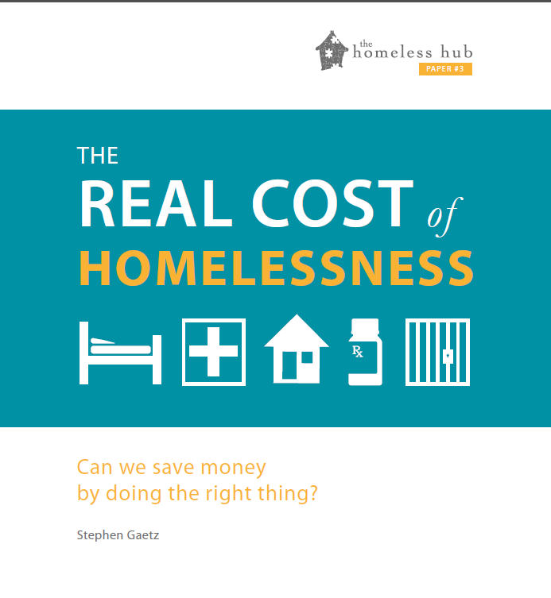
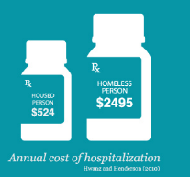
Building Benefits Us All
Housing First has been found to be particularly effective approach to end homelessness for high need populations, such as chronically homeless individuals.
iGulcur, L., Stefancic, A., Shinn, M., Tsemberis, S., & Fishcer, S. Housing, Hospitalization, and Cost Outcomes for Homeless Individuals with Psychiatric Disabilities Participating in Continuum of Care and Housing First Programmes. 2003.
Total cost offsets for Housing First participants relative to controls averaged $2449 per person per month after accounting for housing program costs.
Larimer ME¹, Malone DK, Garner MD, Atkins DC, Burlingham B, Lonczak HS, Tanzer K, Ginzler J, Clifasefi SL, Hobson WG, Marlatt GA. Health care and public service use and costs before and after provision of housing for chronically homeless persons with severe alcohol problems 2009
In a 2005 study by Pomeroy which looked at costs in four Canadian cities, institutional responses (jails, hospitals, etc.) cost $66,000-$120,000 annually, emergency shelters cost $13,000-$42,000 annually whereas supportive and transitional housing cost $13,000-$18,000 and affordable housing without supports was a mere $5,000-$8,000.
Finally, housing affordability may lead to low-quality housing and residential instability. The lack of affordable housing can lead to difficult choices in household budgets—for example, choosing between paying the rent or paying for food and other necessities like adequate health care. Families with affordability issues may choose lower quality housing to make up for the gap in income. Financial trouble may also negatively affect children’s academic performance and behavioral development (Pribesh and Downey 1999).
Notes:
I am not going to tell you that building is the right thing to do. I am going to tell you that building is the smart thing to do and unlike the ranters on our infamous local rant and rave facebook page, I will reference the research instead of tossing bully bombs.
Making Kenora Home advocates for housing but we advocate for the right housing. What we believe to be right is backed by fact not opinion.
We know that smaller, scattered developments integrate better into neighbourhoods.
We know that well designed and maintained complexes are assets to neighbourhoods.
We know that public transportation and parking are important issues for marketability.
We know that green space is important to community well being.
We know that for those individuals with multiple challenges, Housing First Services will support tenants and enhance outcomes. Enhance outcomes for individuals and there is a cumulative impact the reverberates through the community.
We know this because we brought in Iain DeJong to our community. We have spoken with Sam Tsemberis and his colleagues directly. We have investigated Medicine Hat’s experience. Dan Jorgensen knocked on that’s city’s doors and asked hard questions. It is all laid out for us already. I was with Iain when a local politician began with, “but you don’t understand our mill rate….”. Ian has no patience for excuses and snapped back, “No, you don’t understand-either you want to invest in changing the situation or you don’t. If you want it, make it happen”. Shaun Loney phrased the question that we need to be asking our political representatives-”Do you want to save money?” The time has come for us to increase our Social Return On Investment locally.

Slide 8

Addressing Concerns
Become Part of the Development
Review the information
Be realistic about your role in the process
Name the fears and evaluate them according to evidence
Keep a community well being perspective
Recognize that although some of us may own properties
or businesses but we don’t own the community
Notes:
The KDSB has brought forward three housing spectrum components recently. All have support services attached. The to be named emergency shelter is now open and will serve as a community hub for the homeless of Kenora. The process of pulling together these projects has taken a great deal of effort on the part of the developer. Now it is Kenora’s turn to support which will yield more units for our citizens than any affordable housing development project done within the last 40 years. It is up to our municipality and our citizens to put aside partisan power politics and commit support to these community projects.
This doesn’t mean that there won’t be concerns and resistance because change is hard, particularly the closer the change is to our own lives and homes. As humans we resist change-status quo is comfortable and we do like comfort-but we are also thinking human beings. We can seek out the information that addresses our concerns and become part of the development.
Tonight KDSB has prepared to provide you with the project information. Review it.
Having a role as a citizen means that we need to know that we are only part of the picture. It is not about the little man standing off against a development juggernaut-it is about working together collaboratively to reach the best outcomes for all of us.
There was a whirlwind of words set loose when the funding was announced. Things yammered about often enough take on a negative animation of their own. I am not a fearful person nature and have always evaluated risk on fact rather than opinion. I ask one thing of my neighbours and citizens. Recognize that anger that spurs NIMBYism is really caused by fear. Name the fear and face it.
Are you afraid that your property values will decrease? Face it and research it (here’s a hint-been done and as long as the units are scattered through a community, there is no impact on neighbouring single family homes). Are you afraid that crime will increase? Face it and research it (here’s another hint-remember when the group home was going in by Rabbit Lake-it didn’t happen). Are you afraid that there will be people passed out on the streets of your neighbourhood? (I would remind you that when people have a home of their own, they won’t be sleeping on the streets). Look at each and every fear-name it, do your own research and evaluate based on facts rather than rumours and suppositions.
Be aware that you are part of a community. You may not like everyone or approve of their lifestyles but it is one community. The wellbeing of the entire community is reliant on the wellbeing of all citizens. We’ve already addressed how homelessness carries a cost that impacts all of us financially. If you don’t care about the individuals, care about the cost and make a commitment to reduce the cost through Housing First.
This is for property and business owners. Although the property tax flag is often raised to gain an audience, the truth is that we are all tax payers in one way or another. Having the money to own property does not entitle us to eminent domain. In plain language, you may own your home but owning your home does not entitle you to use that vacant lot as your private dog park. If you want a dog park, work with community planners to develop one rather than trying to prevent a housing project from going forward. We are all part of this community and the greater good must always be put forward ahead of our own personal preferences.

Slide 9
Notes:
Thank you for your attention. There is some further very good information that will help you to understand why supportive housing in Kenora must become a reality in order for Kenora to become a healthier and safer community. This community is our hometown.

